Slide 1

Cyber Security
Lecture # 03

Slide 2
Lecture Overview
Cyber Threat Landscape
Understanding Essential Security Concepts
Identify the Top Threats in Cyber Security
Difference b/w Cyber Sec & Information Security

Slide 3
Cyber Threat Landscape
The threat landscape means the entire scope of potential and recognized cybersecurity threats affecting user groups, organizations, specific industries, or a particular time.
Shaped by threat actors like hackers, nation-states, and criminal groups, it has grown increasingly complex with the rise of cloud computing, IoT devices, and interconnected supply chains.

Slide 4
Cyber Threat Landscape
The current threat landscape shows a rise in persistent and potential threats, which are becoming more frequent and sophisticated. As digitization and geopolitical issues rise, attack techniques have diversified and now target both infrastructure and individuals.
Quick Questions?
Hackers : Individuals who exploit system vulnerabilities — some for learning (ethical hackers), others for harm (black hats).
Nation-States : Cyberattacks sponsored by governments to steal data, disrupt infrastructure, or spy on other nations.
Criminal Groups : Organized groups that launch cybercrimes like ransomware, phishing, and financial fraud for profit.

Slide 5
Key factors contribution
The main factors contributing to the dynamic threat landscape include:
Increasingly sophisticated tools and attack methods.
Greater reliance on information technology products and services, such as SaaS offerings.
Networks that encourage and enable the distribution of cybercrime profits, such as the dark web.
Greater availability of skills, personnel, and finances to drive cyber attacks.
External factors, such as a global pandemic or financial crisis.
Faster software releases with added functionality;
New hardware development, such as Internet of Things (IoT) devices.

Slide 6
Current cyber threat landscape
Critical Infrastructure Vulnerabilities
Threat actors increasingly target critical infrastructure systems. Such as Energy Grids, Transportation Networks, and Healthcare Facilities, which are vital to national security and public safety.
The more reliance on interconnected systems also amplifies risks.
The rise in ransomware attacks targeting critical infrastructure highlights the urgent need to strengthen and modernize defenses against evolving cyber threats.

Slide 7
Growing Geopolitical Tensions
Geopolitical conflicts are amplifying the threat landscape.
Nation-state threat actors are using cyber espionage and sabotage to achieve their goals.
These attacks exploit attack vectors like phishing, zero-day vulnerabilities, and ransomware to disrupt essential services, destabilize economies, and undermine public trust.
Cyberattacks often accompany traditional geopolitical moves by targeting critical sectors like energy, finance, and defense.

Slide 8
Examples
The COVID – 19 Pandemic
The Russia Ukraine Conflict
Cloud Service Providers (CSPs) – e.g. Amazon Web Services (AWS), Microsoft Azure, Google Cloud Platform (GCP).
Software-as-a-Service (SaaS) Platforms – e.g. Salesforce, Slack, Zoom, Dropbox
Payment Gateways and Financial Processors – e.g. Stripe, PayPal, Square
Managed Service Providers (MSPs) and IT Support Vendors – e.g. Kaseya, SolarWinds
Supply Chain and Logistics Platforms – e.g. SAP Ariba, Oracle SCM Cloud, Maersk’s logistics systems

Slide 9
Case Studies – 2024 - 2025
Pakistan Petroleum Limited (PPL) Ransomware Attempt — August 2024
Snowflake Data Breach (2024)
UnitedHealth Group (Change Healthcare) Ransomware Attack (Feb 2024)
UK Ministry of Defense Data Leak (May 2025)
AI-Driven Cyber Attacks Surge (2025) – Pakistan
Pakistan’s Financial Sector Hit by 114% Rise in Cyber Threats (2024)
Data Breach at a Government Department (Unconfirmed – Early 2025) – Pakistan
Dark Web Sale of Pakistani Telecom Data (2024)
University Websites Defaced (2024)

Slide 10
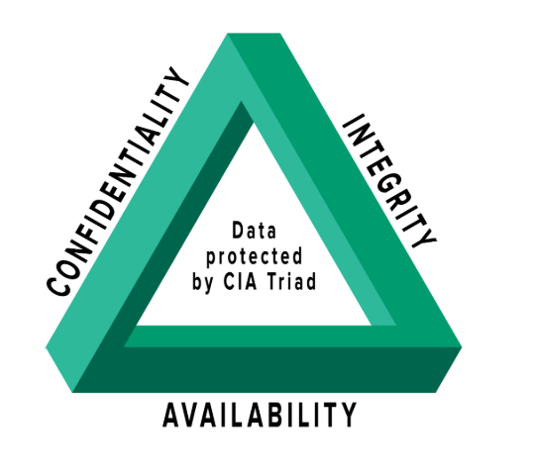
Understanding Essential Security Concepts
1. CONFIDENTIALITY
Ensures information is accessible only to authorized users. Achieved through methods like passwords and encryption.
2. INTEGRITY
Maintains data accuracy and consistency, preventing unauthorized changes. Techniques like checksums verify data authenticity.
3. AVAILABILITY
Ensures data and systems are accessible when needed. Supported by backups, redundancy, and reliable network management.

Slide 11
4. Authentication
Authentication is the process of verifying who someone is before granting access to information or systems. This can be done using usernames and passwords, fingerprints, or other methods.
5. Authorization
Authorization determines what an individual is allowed to do after they are authenticated. It controls access to resources based on a person’s role or rights within an organization.
6. Non-repudiation
Non-repudiation ensures that a person cannot deny actions they have taken in the digital world. This is important for accountability, especially in transactions or communications.
7. Risk Management
Risk management involves identifying, assessing, and prioritizing risks to information and systems. It helps organizations decide how to best protect their assets from potential threats

Slide 12
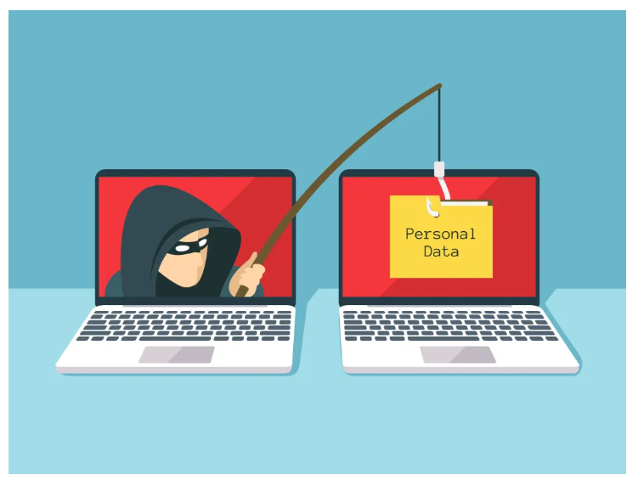
Cyber Threats
Phishing
A cybercrime tactic where attackers trick people into revealing sensitive information (e.g., passwords, banking details) through deceptive emails, messages, or websites.
Attackers pose as trusted individuals or organizations.
They send urgent-sounding messages to create fear
and trick victims into clicking links or downloading
malware.
Victims are redirected to fake websites to steal login
credentials or financial data

Slide 13
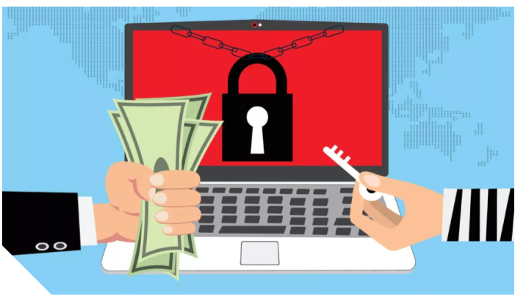
Ransomware
Ransomware is a type of malware that holds a victim’s sensitive data or device hostage, threatening to keep it locked—or worse—unless the victim pays a ransom to the attacker.
The earliest ransomware attacks simply demanded a ransom in exchange for the encryption key needed to regain access to the affected data or use of the infected device.
In recent years, ransomware attacks have evolved to include double-extortion and triple-extortion tactics that raise the stakes considerably
Double-extortion attacks add the threat of stealing the victim’s data and leaking it online.
triple-extortion attacks add the threat of using the stolen data to attack the victim’s customers or business partners.
Global Reports:
2023 - 84% - 2022 (NCC )
68% organizations hit by it
2024 – 11% - 2023
59% organizations hit by it

Slide 14
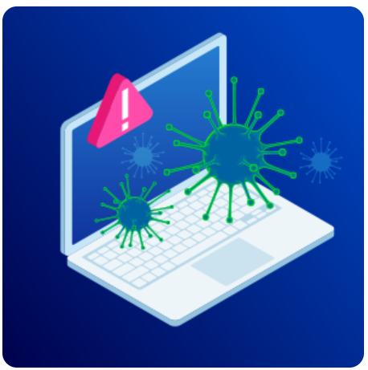
MALWARE
Malware (short for malicious software) refers to any software
intentionally designed to harm, disrupt, or gain unauthorized
access to computers, networks, or devices. It can steal data, damage
files, or spy on user activity.
Common types of malware include:
Viruses: Attach themselves to legitimate programs and spread when those programs run.
Worms: Self-replicating programs that spread across networks without user action.
Trojans: Disguise themselves as legitimate software to trick users into installing them.
Spyware: Secretly monitors user activity and collects sensitive information.
Adware: Displays unwanted ads and can slow down systems.
Rootkits: Hide malicious processes and allow attackers persistent control over a system.
Ransomware: Encrypts data and demands payment for decryption (a rising global threat).

Slide 15
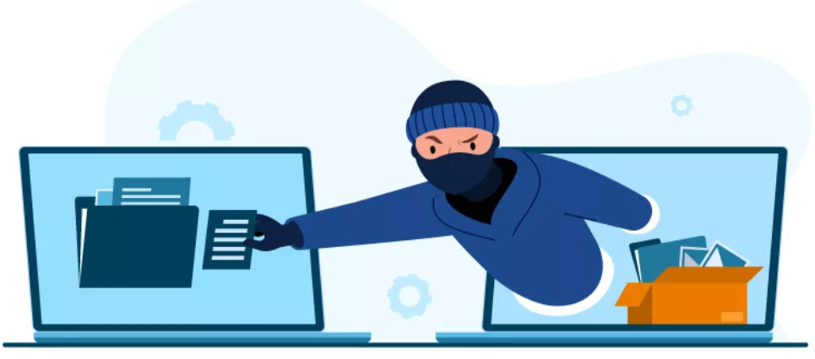
SPYWARE
Malicious actors install spyware on computers without the user’s knowledge, making it malicious software (malware). Its primary purpose is to collect information and data about the user, such as browsing habits, personal information, passwords, or even financial information.
Secretly monitors user activity or steals sensitive data without consent.
Examples of Common Spyware Types
Keyloggers / System Monitors, Adware, Trojans, Browser Hijackers, Rootkits, Password Theft Spyware
Quick Question!
- What is Vulnerability?
A vulnerability is a weakness in a system, hardware, software, network, or process that can be discovered and exploited by an attacker to gain unauthorized access, cause incorrect behavior, steal data, or disrupt services

Slide 16
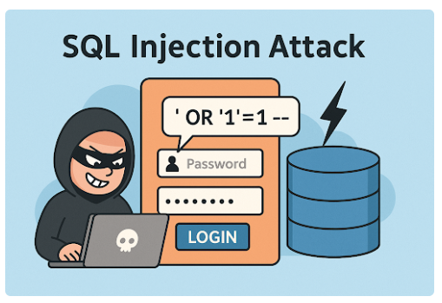
SQL INJECTION
An SQL Injection attack is a type of code injection that exploits vulnerabilities in a web application’s database layer. When input fields (such as login forms or search boxes) fail to properly filter or sanitize user input, attackers can insert malicious Structured Query Language (SQL) statements into a query to gain unauthorized access to data.
What Can SQL Injection Do?
Extract sensitive data (usernames, passwords etc)
Bypass login authentication
Modify or delete database records
Execute administrative operations on the
database
Access internal system files

Slide 17
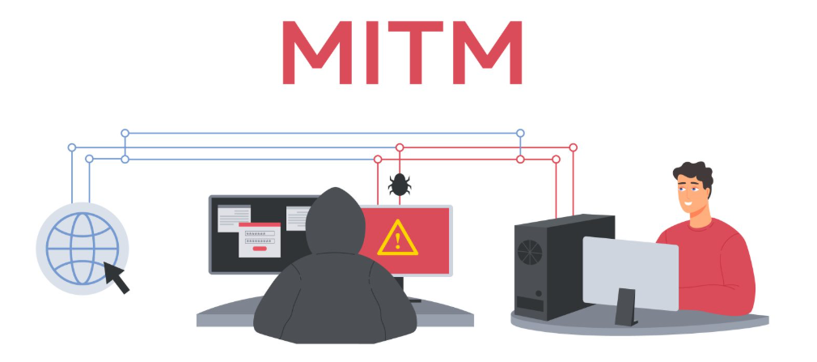
MAN-IN-THE-MIDDLE (MITM)
A Man-in-the-Middle attack is a type of cyberattack where an attacker intercepts and possibly alters the communication between two parties who believe they are directly communicating with each other. The attacker can eavesdrop, modify, and steal sensitive information, making it appear as if the communication is secure and private. MitM attacks can occur in various forms, including eavesdropping on unencrypted communications, session hijacking, and SSL stripping.
Case Study:
Real Case: The Lenovo Superfish
Incident - 2015

Slide 18
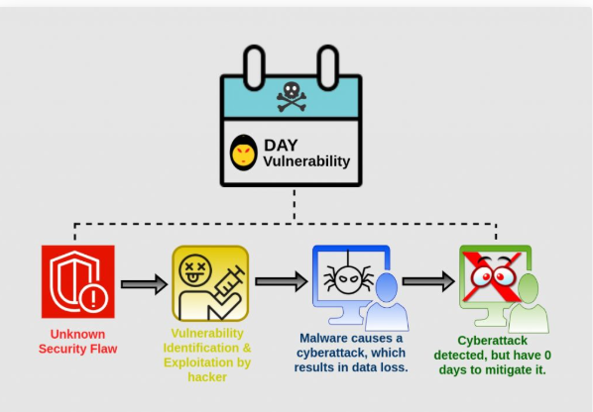
ZERO - DAY EXPLOIT
A zero-day exploit is a cyberattack vector that takes advantage of an unknown or unaddressed security flaw in computer software, hardware or firmware. "Zero day" refers to the fact that the software or device vendor has zero days to fix the flaw because malicious actors can already use it to access vulnerable systems.

Slide 19
Real-World Cases of Zero-Day Vulnerability Attack
Stuxnet (2010)
Overview: Stuxnet was a highly sophisticated computer worm discovered in 2010.
Target: It specifically targeted Iran’s nuclear enrichment facilities, particularly Siemens industrial control systems (ICS).
Impact: The worm caused physical damage to over 1,000 uranium enrichment centrifuges by manipulating their operational speeds while reporting normal readings to monitoring systems.
Technical Details: Stuxnet exploited four separate zero-day vulnerabilities in Windows and industrial software—an unprecedented number at the time.
Suspected Actors: Cybersecurity researchers widely believe the U.S. and Israeli governments jointly developed it as part of a covert operation (Operation Olympic Games), though this remains officially unconfirmed.
Significance: Stuxnet marked the first known cyber weapon capable of causing real-world physical destruction, revolutionizing global cyber warfare.

Slide 20
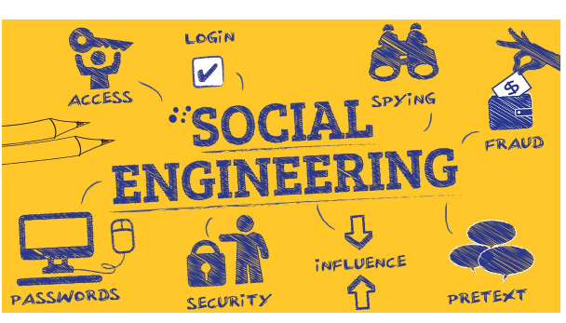
It’s human hacking, it’s the art of manipulating a person so they give up confidential information in order to take over your software, get a password, or get access to your bank information.
A hacker will use different types of communication in order to gain access and get the information they need.
They can use the phone, email, or even in person contact. This type of fraud is built on trust, so they will do their best to appear legitimate.
They can even spoof caller ID to make it look like they are calling from your financial institution

Slide 21
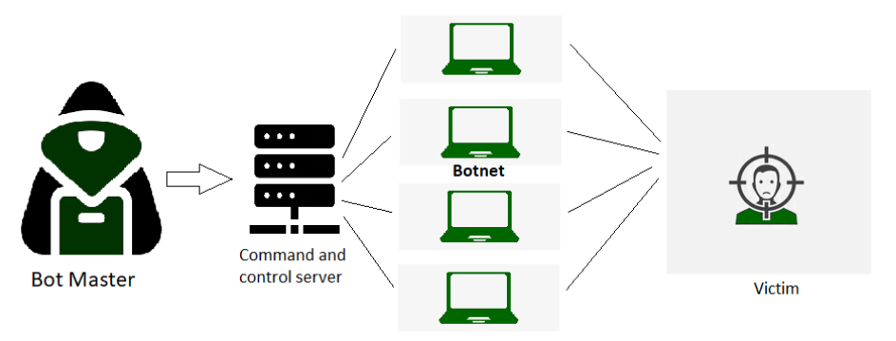
Distributed Denial of Service (DDoS)
A DDoS attack uses multiple servers and Internet connections to flood the targeted resource. A DDoS attack is one of the most powerful weapons on the cyber platform. When you come to know about a website being brought down, it generally means it has become a victim of a DDoS attack. This means that the hackers have attacked your website or PC by imposing heavy traffic. Thus, crashing the website or computer due to overloading.

Slide 22
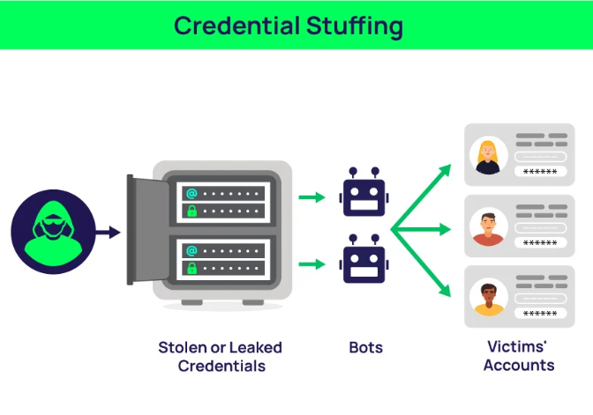
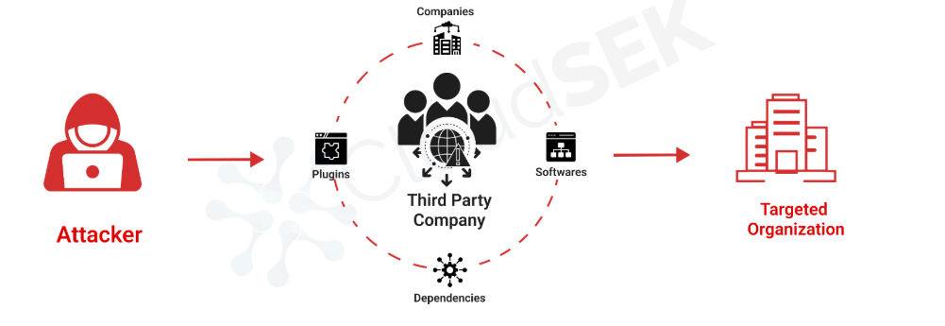
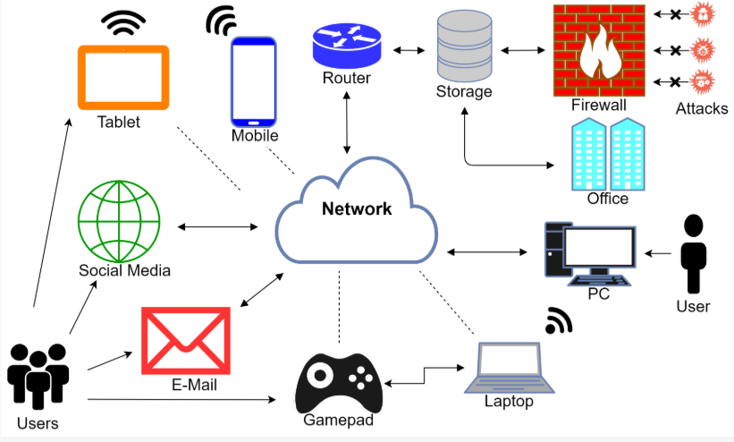
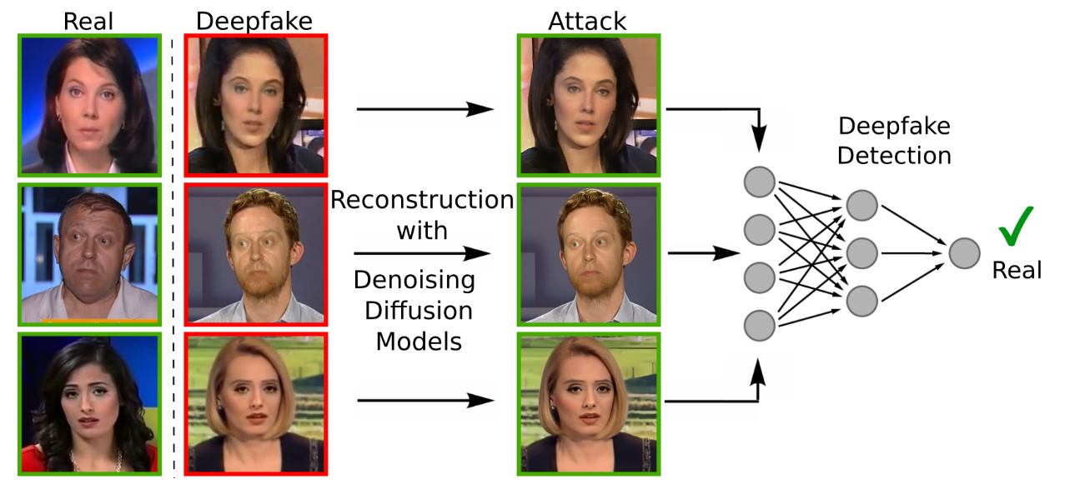
Supply chain Attacks
Deep Fake Attacks
IoT Based Attacks

Slide 23
Difference BTW Cyber Security & Information Security
Cyber Security | Information Security
Protects digital assets like networks, devices, and data from cyber attacks. | Protects all forms of information (digital and physical).
Narrower – focuses on online or computer-related security. | Broader – includes physical documents, conversations, and policies.
Preventing a hacker from accessing an online banking account. | Preventing unauthorized access to confidential files in a filing cabinet.
Ex: Firewalls, encryptions, antivirus, IDS, etc. | Ex: Policies, risk management, compliance, and data classification.

Slide 24
Thank you!
“Stay safe, stay smart, and always think before you click.”

